Slide 1

Achieving PCI Compliance with MySQL
Ryan Lowe & Fernando Ipar
2010 O’Reilly MySQL C&E

Slide 2
Agenda
Overview of PCI
Which requirements apply to us?
Requirement-by-requirement discussion
Questions

Slide 3
PCI DSS
History
Goals
Common Myths
Notes:
Originally 5 Programs - Visa, MasterCard, AMEX, Discover, JCB - 2004 PCI Security Standards Council was formed
1 - To consolidate efforts & eliminate redundancy between organizations
2 - Offload the costs associated with credit card fraud
Myth 1: One vendor and product will make us compliant
Myth 2: Outsourcing card processing makes us compliant

Slide 4
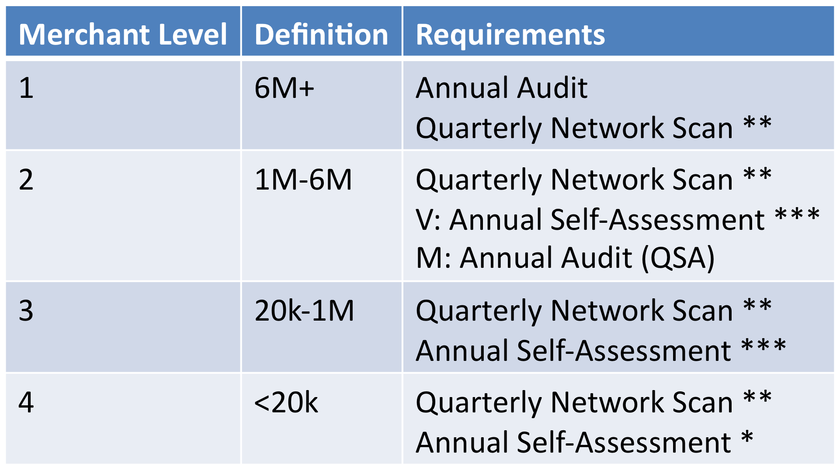
Merchant Responsibility
* Recommended
** Qualified Independent Scan Vendor
*** Merchant

Slide 5
PCI DSS v1.2
Build and Maintain a Secure Network
Protect Cardholder Data
Maintain a Vulnerability Management Program
Implement Strong Access Control Measures
Regularly Monitor and Test Networks
Maintain an Information Security Policy

Slide 6
PCI DSS v1.2
REQ 12 MAINTAIN AN INFORMATION SECURITY POLICY
PHY
REQ 9 PHYSICAL ACCESS CONTROL

Slide 7
PCI DSS v1.2
REQ 12 MAINTAIN AN INFORMATION SECURITY POLICY
PHY
REQ 9 PHYSICAL ACCESS CONTROL
Notes:
Install and maintain a firewall configuration to protect cardholder data

Slide 8
PCI DSS v1.2
REQ 12 MAINTAIN AN INFORMATION SECURITY POLICY
PHY
REQ 9 PHYSICAL ACCESS CONTROL

Slide 9
PCI DSS v1.2
REQ 12 MAINTAIN AN INFORMATION SECURITY POLICY
PHY
REQ 9 PHYSICAL ACCESS CONTROL
Notes:
Do not use vendor-supplied defaults for system passwords and other security parameters

Slide 10
PCI DSS v1.2
REQ 12 MAINTAIN AN INFORMATION SECURITY POLICY
PHY
REQ 9 PHYSICAL ACCESS CONTROL

Slide 11
PCI DSS v1.2
REQ 12 MAINTAIN AN INFORMATION SECURITY POLICY
PHY
REQ 9 PHYSICAL ACCESS CONTROL
Notes:
Protect stored cardholder data

Slide 12
PCI DSS v1.2
REQ 12 MAINTAIN AN INFORMATION SECURITY POLICY
PHY
REQ 9 PHYSICAL ACCESS CONTROL
Notes:
Encrypt transmission of cardholder data across open, public networks
2006-2009 Heartland Breach
Cloud

Slide 13
PCI DSS v1.2
REQ 12 MAINTAIN AN INFORMATION SECURITY POLICY
PHY
REQ 9 PHYSICAL ACCESS CONTROL
Notes:
Use and regularly update anti-virus software or programs
Deploy anti-virus software on all systems commonly affected by malicious software

Slide 14
PCI DSS v1.2
REQ 12 MAINTAIN AN INFORMATION SECURITY POLICY
PHY
REQ 9 PHYSICAL ACCESS CONTROL
Notes:
Deploy anti-virus software on all systems commonly affected by malicious software

Slide 15
PCI DSS v1.2
REQ 12 MAINTAIN AN INFORMATION SECURITY POLICY
PHY
REQ 9 PHYSICAL ACCESS CONTROL
Notes:
Develop and maintain secure systems and applications

Slide 16
PCI DSS v1.2
REQ 12 MAINTAIN AN INFORMATION SECURITY POLICY
PHY
REQ 9 PHYSICAL ACCESS CONTROL
Notes:
Restrict access to cardholder data by business need to know

Slide 17
PCI DSS v1.2
REQ 12 MAINTAIN AN INFORMATION SECURITY POLICY
PHY
REQ 9 PHYSICAL ACCESS CONTROL
Notes:
Assign a unique ID to each person with computer access

Slide 18
PCI DSS v1.2
REQ 12 MAINTAIN AN INFORMATION SECURITY POLICY
PHY
REQ 9 PHYSICAL ACCESS CONTROL
Notes:
Restrict physical access to cardholder data

Slide 19
PCI DSS v1.2
REQ 12 MAINTAIN AN INFORMATION SECURITY POLICY
PHY
REQ 9 PHYSICAL ACCESS CONTROL

Slide 20
PCI DSS v1.2
REQ 12 MAINTAIN AN INFORMATION SECURITY POLICY
PHY
REQ 9 PHYSICAL ACCESS CONTROL
Notes:
Track and monitor all access to network resources and cardholder data
Oracle Audit Manager???
MySQL 5.5 has the Audit Plugin API.

Slide 21
PCI DSS v1.2
REQ 12 MAINTAIN AN INFORMATION SECURITY POLICY
PHY
REQ 9 PHYSICAL ACCESS CONTROL
Notes:
Regularly test security systems and processes

Slide 22
PCI DSS v1.2
REQ 12 MAINTAIN AN INFORMATION SECURITY POLICY
PHY
REQ 9 PHYSICAL ACCESS CONTROL

Slide 23
PCI DSS v1.2
REQ 12 MAINTAIN AN INFORMATION SECURITY POLICY
PHY
REQ 9 PHYSICAL ACCESS CONTROL
Notes:
Maintain a policy that addresses information security for employees and contractors

Slide 24
PCI DSS v1.2
REQ 12 MAINTAIN AN INFORMATION SECURITY POLICY
PHY
REQ 9 PHYSICAL ACCESS CONTROL

Slide 25
Requirement 2
Do not use vendor-supplied defaults for system passwords and other security parameters
“Malicious individuals (external and internal to a company) often use vendor default passwords and other vendor default settings to compromise systems. These passwords and settings are well known by hacker communities and are easily determined via public information.”

Slide 26
Requirement 2
mysql> SELECT user, host, password FROM mysql.user;
+------+-----------+----------+
| user | host | password |
+------+-----------+----------+
| root | localhost | |
| root | testbox1 | |
| root | 127.0.0.1 | |
| | localhost | |
| | testbox1 | |
+------+-----------+----------+
5 rows in set (0.28 sec)

Slide 27
Requirement 2
%> mysql_secure_installation
…
Set root password? [Y/n] Y
…
Remove anonymous users? [Y/n] Y
…
Disallow root login remotely? [Y/n] Y
…
Remove test database and access to it? [Y/n] Y
…
Reload privilege tables now? [Y/n] Y
…

Slide 28
Requirement 2
mysql> SELECT user, host, password FROM mysql.user;
+------+-----------+-------------------------------------------+
| user | host | password |
+------+-----------+-------------------------------------------+
| root | localhost | *F169C0AFEEC30BFF924130B124E6AE3E875D5F60 |
+------+-----------+-------------------------------------------+
1 row in set (0.00 sec)
mysql> SHOW GLOBAL VARIABLES LIKE 'old_passwords';
+---------------+-------+
| Variable_name | Value |
+---------------+-------+
| old_passwords | OFF |
+---------------+-------+
1 row in set (0.00 sec)

Slide 29
Password Hash is NOT Secure
%> strings user.MYD
localhost
root*F169C0AFEEC30BFF924130B124E6AE3E875D5F60
%>
Permissions for datadir, tmpdir, etc
Notes:
http://passcracking.com
Download Rainbow Crack

Slide 30
Requirement 2
2.2.3 – Configure system security parameters to prevent misuse
Be judicious with your GRANTs
Disable local_infile
Disable old_passwords
Set read_only=ON
Enable secure_auth
Notes:
The transfer of the file from the client host to the server host is initiated by the MySQL server. In theory, a patched server could be built that would tell the client program to transfer a file of the server's choosing rather than the file named by the client in the LOAD DATA statement. Such a server could access any file on the client host to which the client user has read access.
In a Web environment where the clients are connecting from a Web server, a user could use LOAD DATA LOCAL to read any files that the Web server process has read access to (assuming that a user could run any command against the SQL server). In this environment, the client with respect to the MySQL server actually is the Web server, not the remote program being run by the user who connects to the Web server.
Questions?

Slide 31
Requirement 3
Protect Stored Cardholder Data
“Protection methods such as encryption, truncation, masking, and hashing are critical components of cardholder data protection. If an intruder circumvents other network security controls and gains access to encrypted data, without the proper cryptographic keys, the data is unreadable and unusable to that person…”

Slide 32
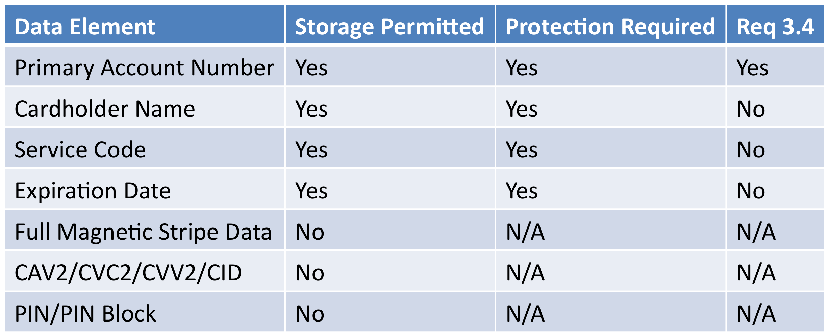
Requirement 3 – Data

Slide 33
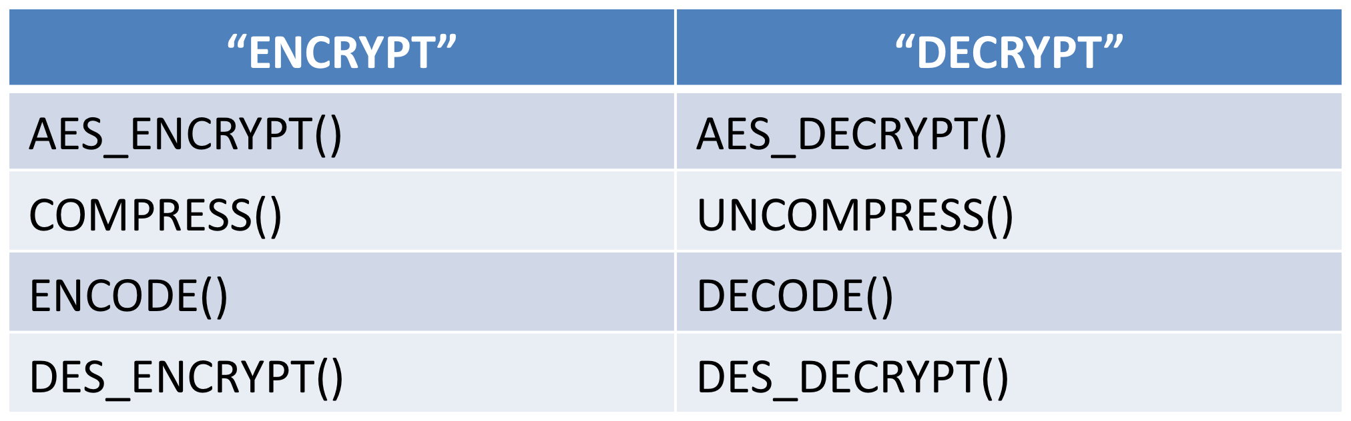
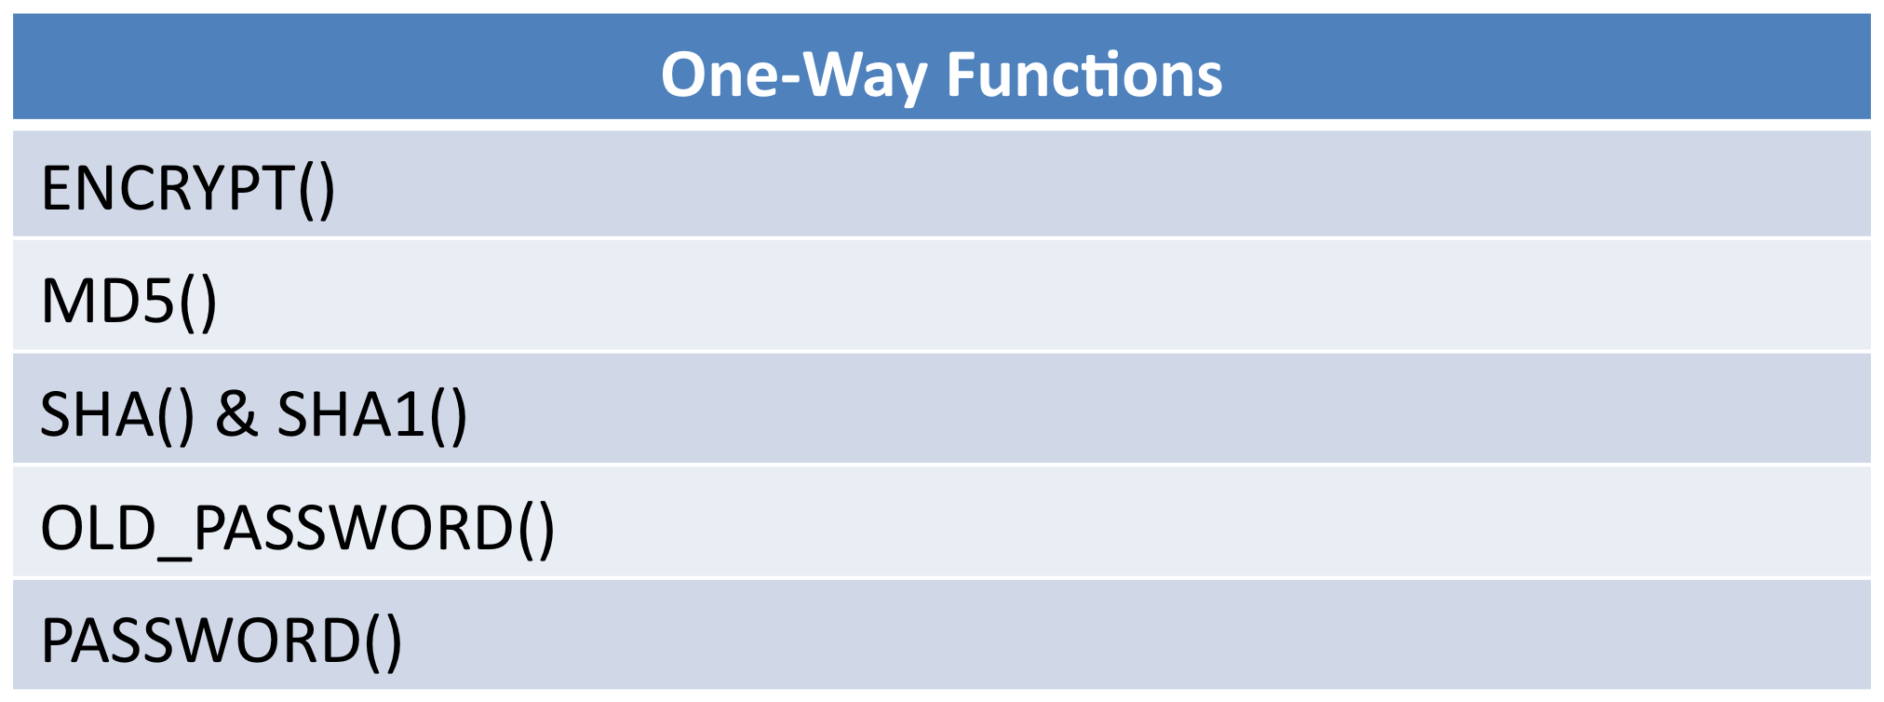
Requirement 3
MySQL Encryption Functions

Slide 34
Requirement 3 - Example
mysql> CREATE TABLE `cc_info` (
-> `id` int unsigned NOT NULL auto_increment,
-> `cc_num` varbinary(32) NOT NULL,
-> `service_code` varbinary(32) NOT NULL,
-> `name_on_card` varbinary(48) NOT NULL,
-> PRIMARY KEY (`id`))
-> ENGINE=InnoDB;
Query OK, 0 rows affected (0.01 sec)
(16*(CEILING(string_length/16)+1))

Slide 35
Requirement 3 - Example
mysql> INSERT INTO `cc_info`
-> (`cc_num`, `service_code`, `name_on_card`)
-> VALUES (
-> AES_ENCRYPT('1234123412341234’,'secret_key'),
-> AES_ENCRYPT('1234', 'secret_key'),
-> AES_ENCRYPT('John Doe', 'secret_key'));
Query OK, 1 row affected (0.35 sec)

Slide 36
Requirement 3 - Example
mysql> SELECT id, cc_num, service_code, name_on_card
-> FROM cc_info\G
***************** 1. row **************************
id: 1
cc_num: ??
? q$?!~c?3Pg?"xu&3?:?,am?
service_code: y.??A??
?? ?a??
name_on_card: ?93s?!? X?8?|nZ
1 row in set (0.00 sec)

Slide 37
Requirement 3 - Example
mysql> SELECT id,
-> AES_DECRYPT(`cc_num`,'secret_key’)
-> AS `cc_num`,
-> AES_DECRYPT(`service_code`, 'secret_key')
-> AS `service_code`,
-> AES_DECRYPT(`name_on_card`, 'secret_key')
-> AS `name_on_card` -> FROM `cc_info`\G *************** 1. row ***************************
id: 1
cc_num: 1234123412341234
service_code: 1234
name_on_card: John Doe
1 row in set (0.00 sec)

Slide 38
Requirement 3 – The Binary Log
%> mysqlbinlog log-bin.000001
...
#100406 16:35:31 server id 1 end_log_pos 461 Query thread_id=1 exec_time=0 error_code=0
use cc/*!*/;
SET TIMESTAMP=1270596931/*!*/;
INSERT INTO `cc_info` (`cc_num`, `service_code`, `name_on_card`) VALUES ( AES_ENCRYPT('1234123412341234', 'secret_key'), AES_ENCRYPT('1234', 'secret_key'), AES_ENCRYPT('John Doe', 'secret_key'))
# at 461 #100406 16:35:31 server id 1 end_log_pos 488 Xid = 6

Slide 39
Requirement 3 – The Binary Log
%> mysqlbinlog -v log-bin.000001
...
BINLOG '
Msa7SxMBAAAANQAAAN0DAAAAAA8AAAAAAAAAAmNjAAdjY19pbmZvAAQD/g8PBv4gIAAwAAA=
Msa7SxcBAAAAZQAAAEIEAAAQAA8AAAAAAAEABP/wBAAAACCY3AusAHEkreUIIX5jyzNQZ90ieHUm
M8Y6BgflLGFtjxB5Lo7nQeK6zQr+wQCVYabiELI5M3P+IYoAWOo4iHxuWhI=
'/*!*/;
### INSERT INTO cc.cc_info
### SET
### @1=1
### @2='??\x0b?\x00q$??\x08!~c?3Pg?"xu&3?:\x06\x07?,am?'
### @3='y.??A??\x0a??\x00?a??'
### @4='?93s?!?\x00X?8?|nZ\x12'
# at 1090 #100406 16:39:30 server id 1 end_log_pos 1117 Xid = 23 COMMIT/*!*/

Slide 40
Requirement 3 – Alternatives
Full Disk Encryption
  Logical access must be managed independently of native operating system access control mechanisms
Encrypt in the Application Layer
  Key Handling & Management Issues
Notes:
expensive, buggy, a performance killer

Slide 41
Requirement 3 – Additional
3.1 – Keep cardholder data storage to a minimum. Develop a data retention and disposal policy. Limit storage amount and retention time to that which is required for business, legal, and/or regulatory purposes, as documented in the data retention policy.
3.2 – Do not store sensitive authentication data after authorization (even if encrypted).
3.3 – Mask PAN when displayed (the first six and last four digits are the maximum number of digits to be displayed).
Don’t Forget Your Backups

Slide 42
Requirement 4
Encrypt transmission of cardholder data across open, public networks
The traffic between datacenters is encrypted at the network layer (secure VPN, for example)
Applicable data is encrypted before being inserted into the database (encrypting in the application layer or using RBR).
You use MySQL Replication over SSL

Slide 43
Requirement 6
Develop and maintain secure systems and applications
“…All critical systems must have the most recently released, appropriate software patches to protect against exploitation and compromise of cardholder data by malicious individuals and malicious software.”

Slide 44
Requirement 6 - Overview
Validation of all input
Validation of proper error handling
Validation of secure cryptographic storage
Validation of secure communications
Separate development/test and production environments
Separation of duties between development/test and production environments
Production data (live PANs) are not used for testing or development
Web Application Security (XSS, CSRF, etc)
Formalizing the process for security updates

Slide 45
Requirement 6
6.2 - Establish a process to identify newly discovered security vulnerabilities
  BugTraq
  MySQL Announce List
6.4 – Follow change control procedures for all changes to system components
  Documentation of impact
  Management sign-off by appropriate parties
  Testing of operational functionality
  Back-out procedures

Slide 46
Requirement 7
Restrict access to cardholder data by business need to know
VIEWs are your friend
Follow Account Best Practices
  Requirement 2

Slide 47
Requirement 7 – Resource Limits
MAX_QUERIES_PER_HOUR
MAX_UPDATES_PER_HOUR
MAX_CONNECTIONS_PER_HOUR
MAX_USER_CONNECTIONS

Slide 48
Requirement 8
Assign a unique ID to each person with computer access
Assign all users a unique ID before allowing them to access system components or cardholder data
Ensure proper user authentication and password management for non- consumer users and administrators on all system components

Slide 49
Requirement 10
Track and monitor all access to network resources and cardholder data
Establish a process for linking all access to system components to each individual user
Implement automated audit trails for all system components to reconstruct events
Record audit trail entries for all system components
Synchronize all critical system clocks and times
Secure audit trails so they cannot be altered
Review logs for all system components at least daily
Retain audit trail history for at least one year, with a minimum of three months immediately available for analysis

Slide 50
Requirement 10 – SANS Top 5
Attempts to Gain Access through Existing Accounts
Failed File or Resource Access Attempts
Unauthorized Changes to Users, Groups and Services
Systems Most Vulnerable to Attack
Suspicious or Unauthorized Network Traffic Patterns

Slide 51
Requirement 11
Regularly test security systems and processes
“Vulnerabilities are being discovered continually by malicious individuals and researchers, and being introduced by new software. System components, processes, and custom software should be tested frequently to ensure security controls continue to reflect a changing environment.”

Slide 52
Requirement 12
Maintain a policy that addresses information security for employees and contractors
12.1 - Establish, publish, maintain, and disseminate a security policy
12.2 - Develop daily operational security procedures that are consistent with requirements in this specification
12.3 - Develop usage policies for critical employee-facing technologies to define proper use of these technologies for all employees and contractors
12.4 - Ensure that the security policy and procedures clearly define information security responsibilities for all employees and contractors

Slide 53
Requirement 12 – Continued
12.5 - Assign to an individual or team security management responsibilities
12.6 - Implement a formal security awareness program to make all employees aware of the importance of cardholder data security
12.7 - Screen potential employees prior to hire to minimize the risk of attacks from internal sources
12.8 - If cardholder data is shared with service providers, maintain and implement policies and procedures to manage service providers
12.9 - Implement an incident response plan. Be prepared to respond immediately to a system breach

Slide 54
Ten Common Myths of PCI DSS
One vendor and product will make us compliant
Outsourcing card processing makes us compliant
PCI compliance is an IT project
PCI will make us secure
PCI is unreasonable; it requires too much
PCI requires us to hire a QSA
We don’t take enough credit cards to be compliant
We completed an SAQ so we’re compliant
PCI makes us store cardholder data
PCI is too hard

Slide 55
Conclusions
Questions
Comments
War Stories

